Slide 1
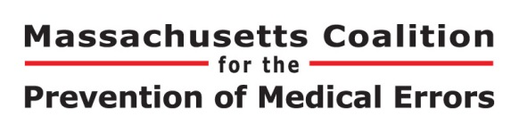
Improvement Journey
Community Learning Session
May 8, 2015
Judy Ling
Coaching Consultant, MA-PIP

Slide 2
Judy Ling
Improvement Advisor on PROMISES project. Worked with 10 small primary care practices as their coach.
Coaching Consultant to Mount Auburn Practice Improvement Program (MA-PIP)

Slide 3
CME Learning Objective
As a result of participating in this activity, learners will be able to:
  1. Describe the role of the practice manager in practice improvement.
  2. Explain the value of practice staff working together as a team, including the value of reaching outside the practice to connect with care partners to coordinate patient care.
  3. Explain the value of collecting a small amount of data to understand the problem.

Slide 4
Disclosure Statement
The Presenter and Content Developers have no significant financial interest/arrangement with any organization(s) that could be perceived as a real or apparent conflict of interest with the subject matter of the presentation.

Slide 5
Improvement Case Study
Small primary care practice, 2 MDs and 1 PA, 4 MAs and office other staff members.
  They wanted to improve the prescription refill process.
  Tom is the Practice Manager, Karen is the Clinical Lead.
For our time together today, please focus on Tom’s role as the Practice Manager.

Slide 6
Practice Manager
What was Tom, the Practice Manager, responsible for in terms of:
  Selecting an improvement topic?
  Organize a team to investigate the refill process?
And, why would Tom want to participate in an improvement project?
Please break into small groups of 2 or 3 to discuss for 3 minutes, then select 1 member to report out

Slide 7
Comments from Groups

Slide 8
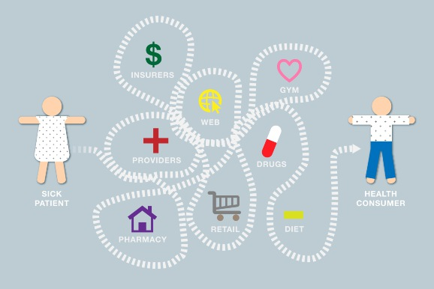
At Your Practice
If you are the PM and see the need to improve a process, what would you do?

Slide 9

What We Learned
The importance of the Practice Manager as the quarter back for the team.
The importance of collecting even a small amount of data…. Beware of assumptions/urban legends.
The importance of teamwork…Inside and outside of the practice.

Slide 10

See Problem, Solve Problem
  What did star performers do?
  Solve problems as a team
  Test ideas. Allow failure
  Discuss errors without fear
  Problems framed as systems issue
  Embrace visits/coaching
  Steal shamelessly
IDEAS
Notes:
JL
Practices have capacity for improvement
Need to give practice managers tools and confidence.
Not knowing what to do when there is a problem leads to band-aid solutions and frustration.
Transition to next slide: Feedback from Practices during Exit Interviews

Slide 11
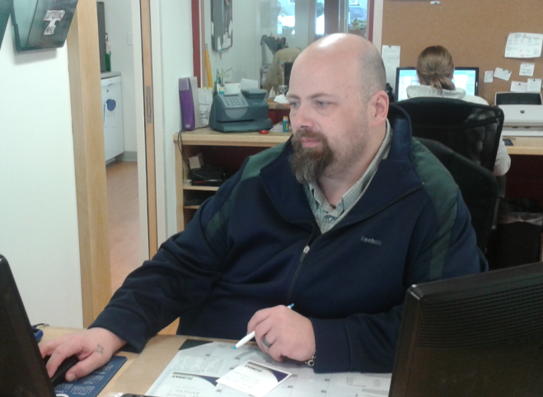
Final Thought from Tom
My whole thought process on how do I recognize a problem to how do I deal with the problem has changed. Before, … My whole time was spent just putting out fires, not really dealing with what is causing the fires, and now, since PROMISES, my whole approach to it is, "okay let's deal with the immediacy of the problem, but let's look further into how we can prevent this from happening again.” Because that, essentially, is what is going to streamline the processes and make us a safer, better practice. That, essentially, is what I walked away with from PROMISES. (Tom)

Slide 12
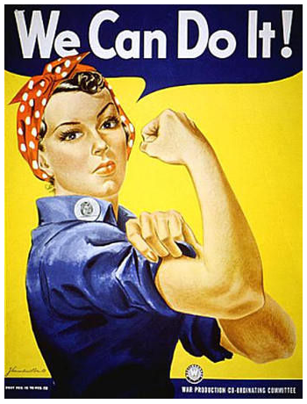
You know, I kind of walked away from the PI project like, "I now know how to do things,” but I was able to apply what we learned this time with PROMISES. (Eagles)
The PROMISES program works. Attacking it in small fundamental bites, and mapping out the process and finding out where the actual problems are is a process that I hope everyone learns. (Dragonfly)
I was actually at a Blue Cross meeting, and Paula Griswold was giving an end-of-life talk, … And I thought, “hey I can do that,” as opposed to before I might not have attempted it. (Burberry)

